Slide 1
RCS Webinar part 2

Slide 2
Agenda
https://coarc.com/news/rcs-webinar-5-8-24-recording-materials/
Adding Personnel
Outcomes/Reports
Surveys
Final tips & takeaways
Q&A

Slide 3
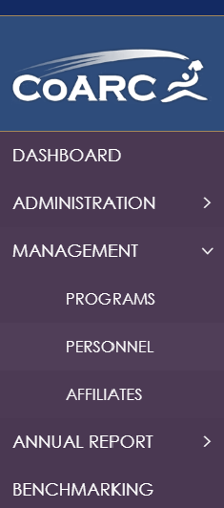
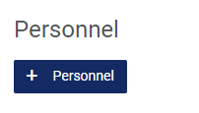
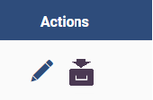
Adding Personnel
Personnel Tab (sub‐tab of Confirm Information Tab) Update program personnel information, as necessary. If a position is unfilled at the time of RCS submission, insert “vacant” into the title. o Existing information can be edited by clicking the “make changes” button. o New information that needs to be added needs to be done through the management tab on the left‐hand side of the page/personnel/+personnel. o The Program Director’s information can be updated in the upper right‐hand corner of the page. If no changes need to be made, click the “No Changes Made” button. At minimum, you need to make sure your DCE, Medical Director, and Dean are in the system. ​

Slide 4
Outcomes/reports
The Annual School Summary should have years 2021‐2023. Make sure that your RRT and TMC High Cut Outcomes match what this report has listed. We need this report to verify credentialing success.
The TMC Graduate Performance Report is based on who passed the exams and shows the high cut score data. The annual school summary will have the number of students that passed. This report will have the names of the students who passed, make sure these reports match. This will be a 3‐year report i.e., for the 2024 RCS, run the report from January 1, 2021, through December 31, 2023, unless some of your graduates passed in 2024, then run the report up until July 1, 2024.
The TMC Scores by Content Area should only be run from 1/1/2023‐12/31/2023. This report is used for reference to make sure the analysis that was made in the Outcomes tab is correct.
The CSE Content and Section Type Subscores should only be run from 1/1/202312/31/2023. This report is used for reference to make sure the analysis that was made in the Outcomes tab is correct.

Slide 5
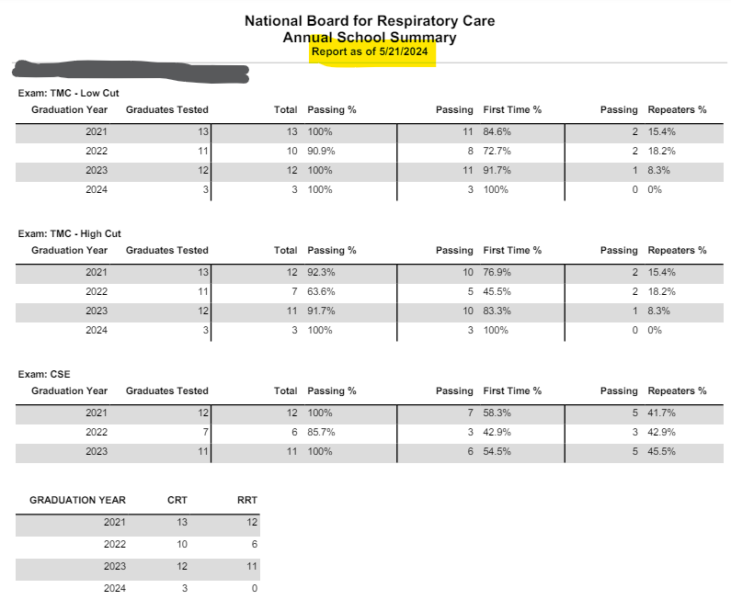
Outcomes/reports
The Annual School Summary should have years 2021‐2023. Make sure that your RRT and TMC High Cut Outcomes match what this report has listed.
Run a “Credentials Earned” report to figure out the names of those who passed for RRT.
Run a “TMC Graduate Performance” report to figure out the names of those who passed at the high cut.

Slide 6
Outcomes/reports
TMC Graduate Performance Report run the report from January 1, 2021, through December 31, 2023, unless some of your graduates passed in 2024, then run the report up until July 1, 2024.

Slide 7
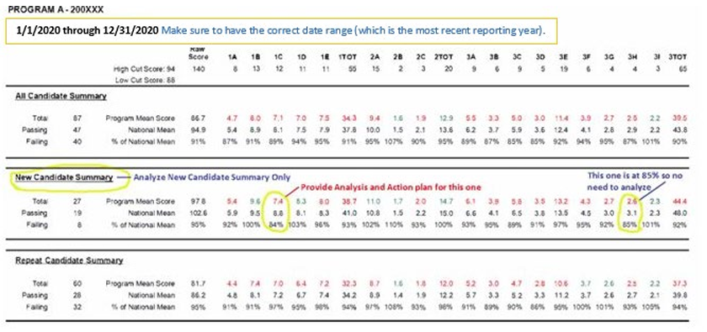
Outcomes/reports
The TMC Scores by Content Area should only be run from 1/1/2023‐12/31/2023.

Slide 8
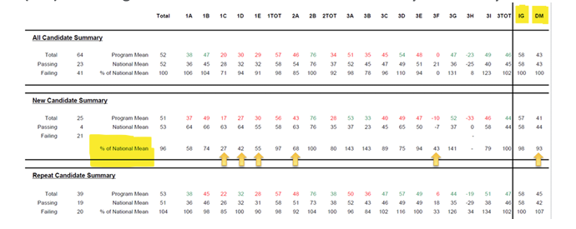
Outcomes/reports
The CSE Content and Section Type Subscores should only be run from 1/1/202312/31/2023.

Slide 9
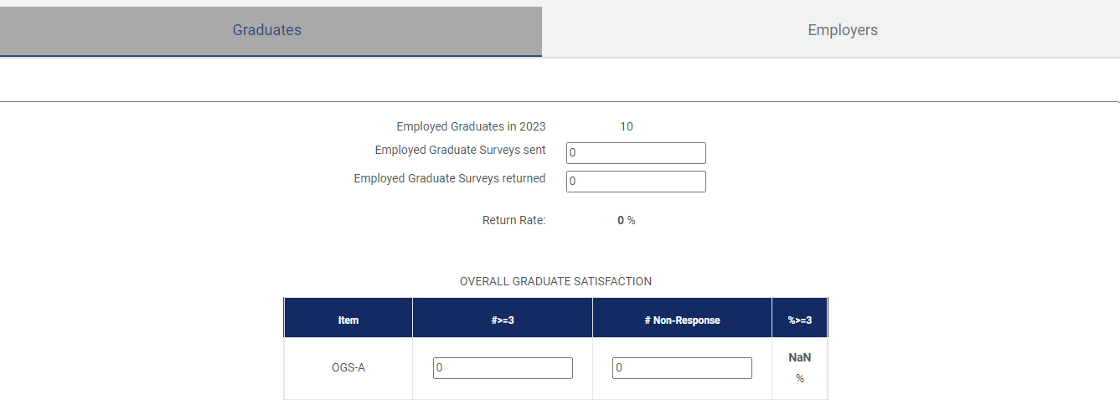
Surveys
Graduate and Employer
https://coarc.com/accreditation-resources/annual-reporting-tool/
Student and Personnel-used for the RAM
https://coarc.com/accreditation-resources/resource-assessment-ram-and-surveys/

Slide 10
Q&a

Slide 11
Final tips & takeaways
Make sure you are using Google Chrome.
If you are going to be idle on your computer (ex. must step away), make sure to click the next button because you can always go back, it just will NOT save your information until you click next. I would also keep a word copy of your work just in case it does NOT save.
You should have a login, if not, email me.
Report is due JULY 1st!!!

Slide 12
Thank You
Tammy Alsup
tammy@coarc.com

