Slide 1

Update on 2025 CoARC Standards for Entry into Respiratory Care Practice
Thomas Hill, PhD, RRT, RRT-NPS, RPFT, FAARC
Chair, Standards, Policies, and Bylaws Committee
Thomas Smalling, PhD, RRT, RRT-SDS, RPFT, FAARC
Chief Executive Officer

Slide 2
Conflict of Interest
Nothing to Disclose
Notes:
THIS IS A REQUIRED SLIDE: IF YOU HAVE NO COI TO DISCLOSE, PLEASE TYPE “NOTHING TO DISCLOSE” OR “NONE”.

Slide 3
Learning Objectives
This session will provide an overview of the proposed 2025 Accreditation Standards for Entry into Practice Programs and their implications for programs and the profession. Emphasis will be placed on the new differentiated degree framework and the process/timeline for completing the revision.
  Objective 1: Review the process and timeline for approval and implementation of the 2025 accreditation standards and recognize potential effects on programs and the profession.
  Objective 2: Describe key differences between the current and proposed new formats.
Notes:
Entry into Practice Standards only – no changes to Standards for Degree Advancement and APRT at this time.

Slide 4
The Revision Process
As part of its 5-year review cycle, CoARC is developing its 2025 Standards.
A timeline for the revision was published on our website, and programs/organizations were recently notified of the timeline/process.
This will be a comprehensive revision of the Entry Standards with an expected release date of late 2025.

Slide 5
The Revision Timeline
Between July and Nov 2023, the CoARC Standards Committee:
  Reviewed and discussed new format options and objectives.
  The primary objective is to create a new framework for the 2025 Standards that align with the different degree offerings.
  The new document will continue to emphasize a competency-based, outcomes-focused approach to program evaluation.
Notes:
CoARC will continue its outcomes-centered approach to the accreditation review process;
Based on the importance of a competency-based approach to accreditation, revisions in the 2025 Standards will likely reflect a continued emphasis on student learning outcomes that focus on the competencies and attainment levels reached by respiratory care students upon entry into practice.

Slide 6
The Revision Timeline
Following November 2023 CoARC Board meeting, the Standards Committee will:
  Identify representatives from the communities of interest who will be willing to serve on the Committee. This will be an expanded group of individuals in addition to the Committee members;
  The Committee will develop surveys for existing programs and advisory committees to determine what graduates are doing (beyond what is on the TMC content outline).
Notes:
Teach only to the NBRC exam? Tail-wagging the dog
Create the graduate that the profession and the employers want
An entry into practice education process that includes input from both the educators, graduates and employers of the respiratory therapy workforce increases the potential for development of a realistic and acceptable approach to rational workforce planning and production.

Slide 7
Difference from Previous Process/Timeline
For 2020 Standards, communities of interest were asked to provide feedback on 2015 Standards before the Committee began the review process.
For 2025 Standards, the Committee will develop an initial draft for consideration by the communities of interest.

Slide 8
Fundamental Question?
Do you think respiratory care graduates of an Entry into Practice Program should acquire the same competencies (knowledge, skills, abilities) regardless of the degree they earn?
Notes:
Ask for show of hands?

Slide 9
The answer is No…
The development of respiratory care workforce projections continues to be a challenging goal;
The variety of respiratory care programs and the graduates produced in these programs has resulted in a mix of practitioners with different competencies yet similar role expectations as they enter the workforce.
Recently, a greater focus has been placed on the expansion of enrollments in the nation’s respiratory care programs and improving the public’s awareness of respiratory care as a desirable profession.
Notes:
The caution is to not fall into the hole of focusing on enrollments and expansion without being purposeful.

Slide 10
A New Format
The 2025 Standards will have a completely new layout with added sections;
It will be a web-based document that takes advantage of a user-friendly, and interactive format;
Functionality and accessibility are superior to a static document.
Notes:
Already have three standards documents – that’s why this format was selected (to avoid having 5).

Slide 11
Standards (beyond those of 3.01) will be revised to include specific requirements for accreditation based on the degree earned.
Not all Standards will have differentiation.

Slide 12
The same will occur for the Evidence of Compliance and Interpretive Guidelines

Slide 13
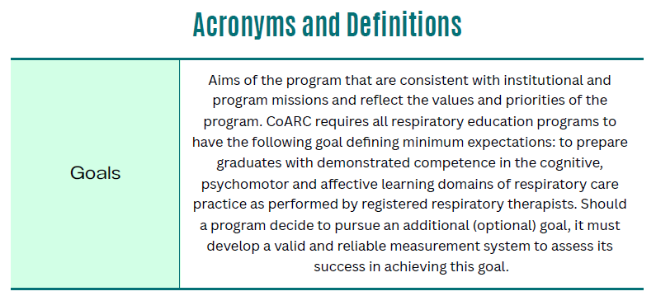
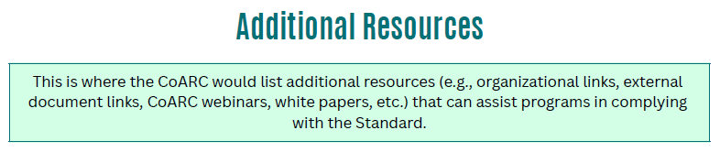

Slide 14
Revisiting Competencies
Any revisions to the respiratory care education process must explicitly recognize that different respiratory care competencies are needed in the health care system and that the variety of educational programs that exist must direct their resources to prepare a differentiated graduate based on the mission of the sponsoring institution and the needs of the health care system.
Notes:
Competency-based education aims to develop “a health professional who can practice medicine at a defined level of proficiency, in accordance with their academic degree preparation, to meet local needs” .
This approach extends beyond teaching traditional respiratory care knowledge and skills to include comprehensive training that prepares graduates for today's healthcare professionals' complex and differentiated roles.

Slide 15
Why the Emphasis on Competencies?
Education has shifted from a traditional, curriculum-centric approach of defining required courses to an outcomes-centric approach that establishes requisite competencies as the primary means to assess the achievement of expected student learning outcomes.
Increased demand for allied health professionals who offer a wider range of clinical skills, greater experience in independent practice, more flexibility in adapting to various practice settings, and who are culturally sensitive, team-focused, and possess interpersonal and listening skills
(O' Neil & Pew Health Professions Commission, 1998, p. 47).
Notes:
In today’s knowledge economy, it is not sufficient for a graduate to demonstrate adequate basic cognitive skills and professional competencies. The nature of the healthcare field also requires the graduate to work in teams, be a creative problem solver, and communicate with a diverse set of colleagues and patients. Employers and higher education institutions have “become more cognizant of the role that such so-called ‘soft’ or non-cognitive skills play in the successful performance in both academic and nonacademic arenas” (Swyer, Millett, & Payne, 2006, p. 14).

Slide 16
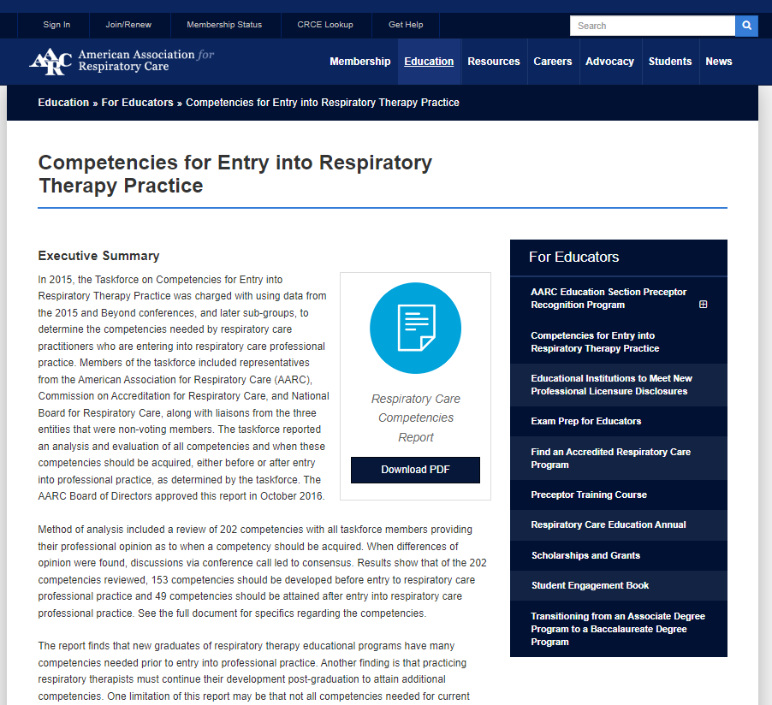
Revisiting Competencies
The current Entry into Practice Standards identify four core competencies;
Specific competencies were identified by the AARC’s Taskforce on Competencies for Entry into Respiratory Therapy Practice (available at aarc.org) and published in October 2016.
Notes:
In 2015, the Taskforce on Competencies for Entry into Respiratory Therapy Practice was charged with using data from the 2015 and Beyond conferences, and later sub-groups, to determine the competencies needed by respiratory care practitioners who are entering into respiratory care professional practice. Members of the taskforce included representatives from the American Association for Respiratory Care (AARC), Commission on Accreditation for Respiratory Care, and National Board for Respiratory Care, along with liaisons from the three entities that were non-voting members. The taskforce reported an analysis and evaluation of all competencies and when these competencies should be acquired, either before or after entry into professional practice, as determined by the taskforce. The AARC Board of Directors approved this report in October 2016.
Method of analysis included a review of 202 competencies with all taskforce members providing their professional opinion as to when a competency should be acquired. When differences of opinion were found, discussions via conference call led to consensus. Results show that of the 202 competencies reviewed, 153 competencies should be developed before entry to respiratory care professional practice and 49 competencies should be attained after entry into respiratory care professional practice. See the full document for specifics regarding the competencies.

Slide 17
Revisiting Competencies
The document was developed by analyzing data from the 2015 and Beyond workshops;
Not all competencies needed for current respiratory therapy practice were captured with the analysis at that time.
Notes:
One limitation of this report may be that not all competencies needed for current respiratory therapy practice are captured with this analysis. Nonetheless, failure to obtain these competencies directs the profession to identify that, to meet the demands of delivering patient care safely in critical care areas and for disease management, patients will not be receiving the respiratory care that they expect and deserve.

Slide 18
Revisiting Competencies
The 2025 Standards will bring revisions to the layout and expansion of expected core competencies;
Areas of focus will include (but not be limited to):
  Clinical Reasoning and Decision-making
  Evidence-Based/Patient-Centered Practice
  Information Literacy
  Interpersonal and Communication Skills
  Professionalism and Interprofessional Practice
Notes:
Further delineation of the competencies is expanded through sub-competencies with accompanying required subject content (Knowledge) and expected Clinical Judgments and Behaviors.
The competencies for each educational level build upon the competencies from the previous level.
differences in competencies among educational levels reflect their respective assignments, level of autonomy in planning and practice decisions, required supervision, administrative roles, leadership responsibilities, and capacity for evaluation of care and caregivers.

Slide 19
Questions and Answers tom@coarc.com
Notes:
Not sure if you also want your email on this.

