Slide 1
Value of Degree Advancement Accreditation
Joe Coyle MD, FCCP, Clinical Professor &
Kristen McHenry EdD, RRT-ACCS, Assistant Professor Department of Respiratory Care
Notes:
This slide is required. Presenter name, credentials, company and title.
Enter the approved lecture title as detailed in your invitation to present.
You may also add a company/employer logo in the designated space.

Slide 2
Conflict of Interest
McHenry discloses relationship with Commission on Accreditation for Respiratory Care (CoARC) as a site visitor and at-large board member
Coyle discloses Clinical Professorship at Boise State University, CoARC DA committee membership and accreditation site visitor
Notes:
This is a required slide.
If there are no COI then please type None or the equivalent.

Slide 3
Learning Objectives
Objective 1: Describe how CoARC accreditation may benefit programs offering degree advancement options.
Objective 2: Discuss the outcome value of degree advancement to Respiratory Therapists and employers.
Notes:
This is a required slide.
List at least 2 of the approved learning objectives in your invitation

Slide 4
What is degree advancement?
An educational program designed to meet the needs of practicing respiratory therapists who, having already earned an Entry into Practice Care Professional Practice degree, wish to obtain advanced training related to Respiratory Care.
-CoARC Policy 12.03

Slide 5
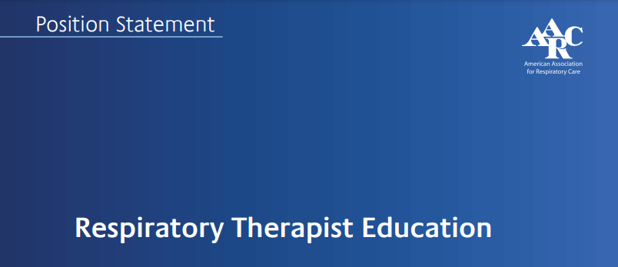
AARC Position Statement
“The AARC (2018) encourages Respiratory Therapists who have completed the required entry level education to pursue baccalaureate and graduate degrees relevant to their professional pursuits.”

Slide 6
Points of Entry into Practice
Associate’s Degree (AS, AAS, AOS)
429 Potential Points of Entry into the Profession
Currently 344 Associate Degree Programs Accredited by CoARC
1
Bachelor’s Degree (BS, BAS)
There are currently 77 Bachelor Degree Programs Accredited by CoARC
2
Master’s Degree (MS)
There are currently 8 Master’s Degree Programs Accredited by CoARC
3
Notes:
Advanced training will look different depending on the individual’s point of entry into the profession (not counting letters of intent)

Slide 7
DA Program Goals
To provide graduates of entry into respiratory care professional practice degree programs with additional knowledge, skills, and attributes in leadership, management, education, research, and/or advanced clinical practice that will enable them to meet their current professional goals and prepare them for practice as advanced degree respiratory therapists.
-CoARC DA Standard 3.1
Notes:
At minimum, all programs must have at least this stated goal, how it is achieved and the focus areas will differ from program to program. The KSAs or domains of educational activities (cognitive, psychomotor, and affective) should reflect the expected qualities or characteristics of the advanced respiratory therapist. Focus areas can help formulate ESLOs.

Slide 8
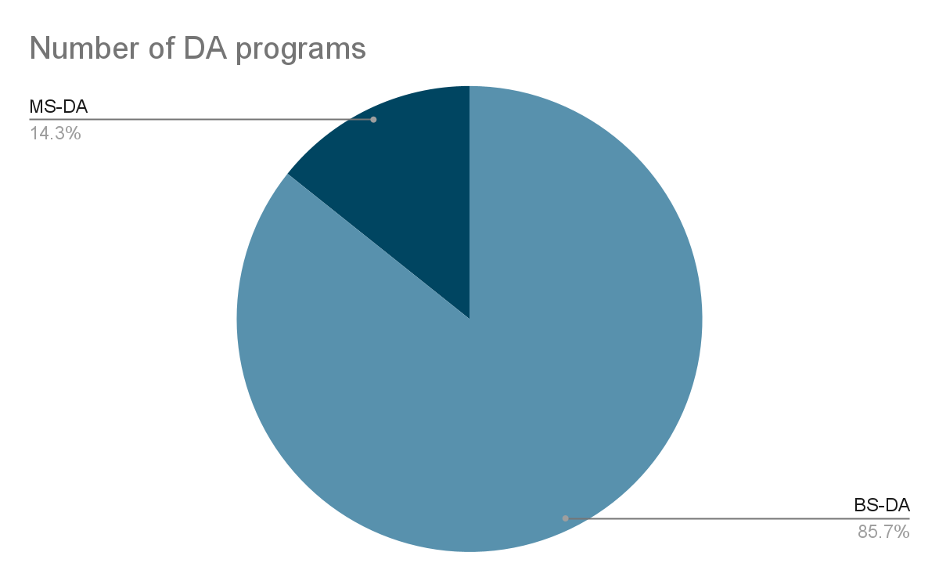
Accredited DA Programs
Programs located in the following states:
NC
MI
OH
CT
MO
FL
ID
CA
IN
NE
KY
KS
VA
TX
ND
NJ
1 APRT Program
4 MS Programs
24 BS Programs
6 Letters of Intent
Notes:
There are several more program under review or are in the process of seeking accreditation (letter of intent); 19 states have an accredited DA program

Slide 9
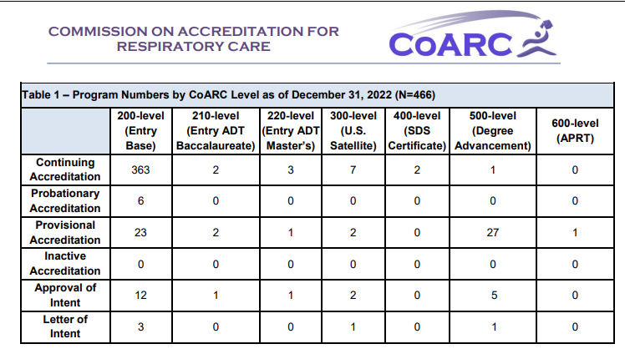
2022 Report on Accreditation

Slide 10
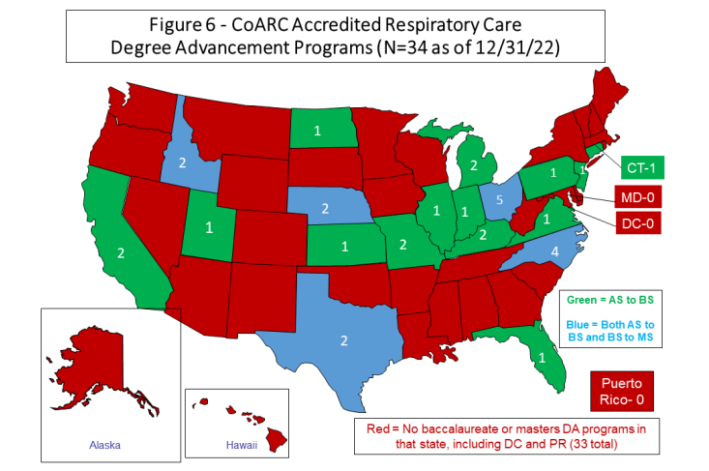
2022 Report on Accreditation
Notes:
Idaho, Texas, NC, Ohio & Nebraska all have two types of DA programs; Ohio has the most at 5 followed by NC at 4

Slide 11
Value of Programmatic Accreditation
Consumer Protection
transparency through published outcomes
Advances & Enhances the Profession
relevant content and competencies
Protection of Educational Quality
faculty resources, institutional support
Continuous Program Improvement
annual reporting and scheduled site visits
External Validation
public recognition of compliance with standards

Slide 12
Benefit to Programs Offering DA
Prospective students seeking to learn skills at an advanced level will be able to better find your program thanks to published information
Transparency and accountability afforded to your students through quality metrics
Contribution to the development of standardized competencies for each level of degree advancement
Demonstrate value of continuing education to stakeholders (employers, patients, HC team)
Notes:
Visibility of the program can aid to recruit and retain

Slide 13
Benefit to Programs Offering DA
You are creating the next generation of leaders in the profession by offering degree advancement opportunities; impacting the trajectory of their careers and personal lives
CoARC (executive office and board of commissioners) is here to serve in a consultative function to help programs be successful
Notes:
DA serves as a pathway to leadership positions or other promotions/role changes which may equate to more opportunities and compensation

Slide 14
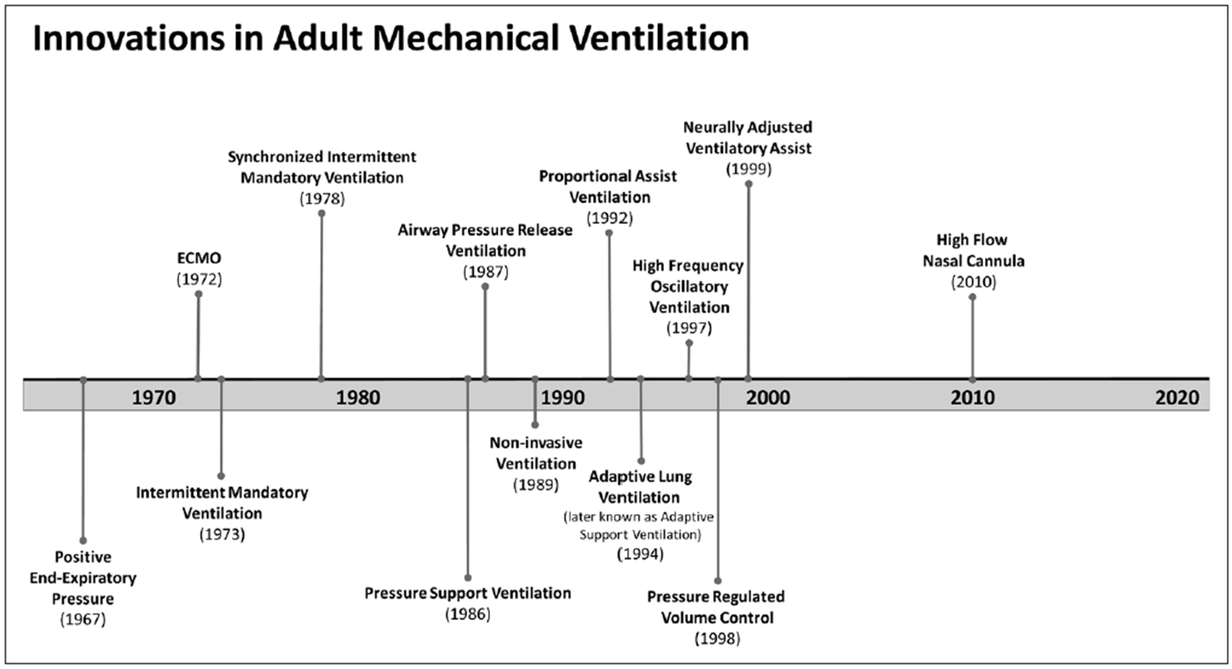
Complexity of the Profession
MacIntyre et al., 2021

Slide 15
Complexity of the Profession
Modalities of Modern Ventilatory Support:
Ventilator Waveform Graphics
APRV
NAVA
Automated Weaning Algorithm
Proportional Assist
Adaptive Support
Esophageal Pressure Monitoring
Volumetric CO2
Electrical Impedance Tomography
Ultrasound of the Lung
Transpulmonary Thermodilution

Slide 16
Clinical Specialist Roles for RTs
Adult Critical Care Specialist
Neonatal & Pediatric Specialist
ECMO Specialist
Critical Care Transport
Care Navigators (Asthma, COPD, NMD)
Sleep Medicine Specialist
Pulmonary Rehabilitation
Interventional Pulmonology
Notes:
Distinct from APRT

Slide 17
2017 Graduate Survey
28 out of 65 responded (RR = 43%)
100% felt we were meeting our BSRT Program Goal
Solid support (>90%) for meeting all SLOs
50% have advanced career since graduation
Secured a position at a hospital they prefer 25%
Promoted to Manager or Supervisor 14.3%
Secured Educator Role 14.3%
Advanced Practice Opportunity 17.9%
Involved in Clinical Research 10.7%
Entered Masters Program 25%

Slide 18
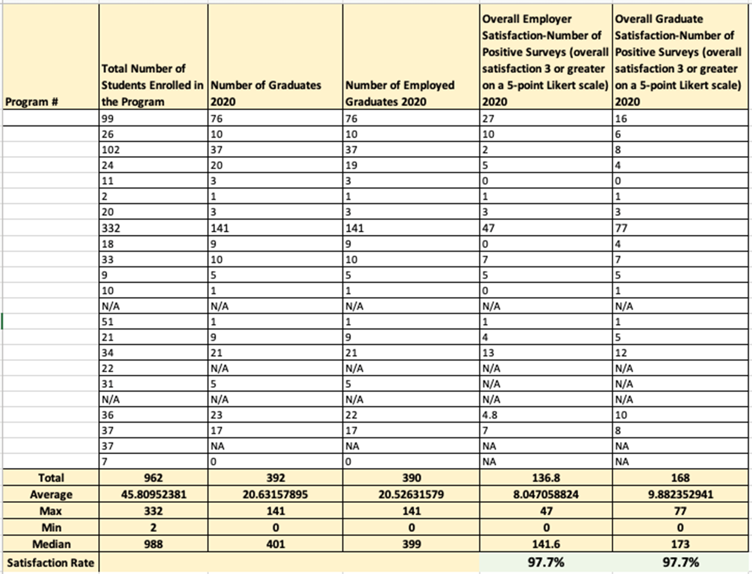
Early DA Program Outcomes 2020

Slide 19
2023 Boise State MSRC Graduate Survey
•30 of 51 graduates responded to date
•High level of satisfaction with meeting ESLOs
•$11.729 increment in annual salary
–1 decrease, 5 no change, 26 increased Average $11,000
•28 of 30 felt the program prepared them to take on new roles and they would recommend the program to a colleague (2 undecided)
•Professional Advancement 66.7%
–12 No professional advancement to date 33%
–8 Supervisory positions
–6 Secured preferred position
–3 Advanced credentials
–2 Educator positions
–1 Clinical Research position
–2 Other types of Advancement

Slide 20
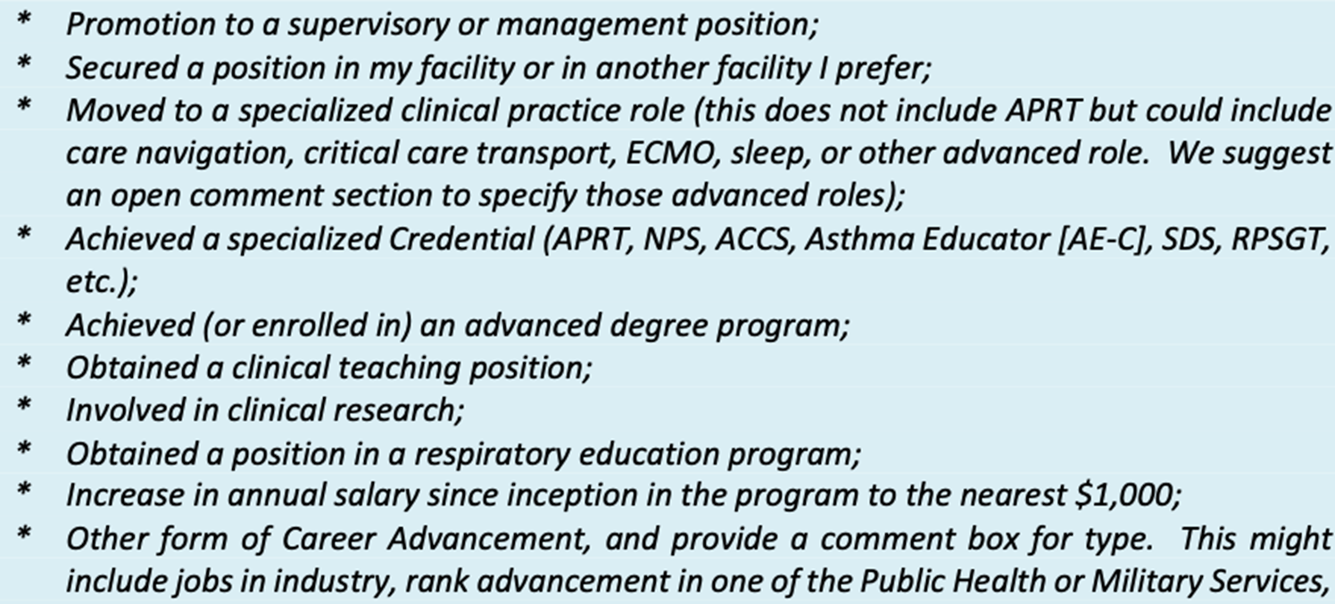
New Outcome Reporting

Slide 21
Revisions to DA Standards July 2023
•Eliminate need for Clinical Elements
–DCE, Medical Director, Section 6 of former standards
•Reporting on Outcomes
–Evidence of Professional Advancement
•Practicum
–Max 6 credits
–Orientation to Clinical Specialty Position, Management, Education
–Academic Deliverables

Slide 22
Future Considerations
APRT Standards revised in 2022
Competency based
PA template of competencies used
APRT approved by VA System
Daniel Whitt with thank you to Drs. Varekojis, Vines, Joyner, and Croft
2028 version of DA Standards to move to competency based.
Align educational level with clinical roles
All input appreciated.

Slide 23
References
AARC. (2018). Respiratory Therapy Education Position Statement. https://www.aarc.org/wp-content/uploads/2017/03/statement-of-respiratory-therapist-education.pdf
CoARC. (2023). Accreditation Policies and Procedures Manual. https://coarc.com/wp-content/uploads/2023/05/CoARC-Accreditation-Policies-3-2023.pdf
CoARC. (2023). Accreditation Standards for Degree Advancement Programs in Respiratory Care. https://coarc.com/wp-content/uploads/2023/01/CoARC-DA-Standards-6.1.2023.pdf
CoARC. (2023). 2022 Report on Accreditation in Respiratory Care Education. https://coarc.com/wp-content/uploads/2023/04/2022-CoARC-Report-on-Accreditation-3-27-23.pdf
MacIntyre, N., Rackley, C., & Khusid, F. (2021). Fifty Years of Mechanical Ventilation-1970s to 2020. Critical Care Medicine, 49(4), 558–574. https://doi.org/10.1097/CCM.0000000000004894

Slide 24
Questions?
Thank you for your time and attention!
Kristen: kristenmchenry@boisestate.edu
Joe: joecoyle@boisestate.edu

