Slide 1
*Incorporating IPE Into Respiratory Care-2023
Shelley C. Mishoe, PhD, RRT, FAARC, FASAHP
Professor Emeritus, Old Dominion University
Associate Provost, Dean, Professor Emeritus, Medical College of Georgia at Augusta University
Notes:
This slide is required. Presenter name, credentials, company and title.
Enter the approved lecture title as detailed in your invitation to present.
You may also add a company/employer logo in the designated space.

Slide 2
Conflict of Interest
I have no actual or potential conflict of interest in relation to this program/presentation.
I have these disclosures of relationships:
  Association of Schools of Allied Health Professions
  Bon Secours Mercy Health System
  CoARC Board of Director
Notes:
This is a required slide.
If there are no COI then please type None or the equivalent.

Slide 3
Learning Objectives
Define interprofessional education (IPE) and interprofessional collaborative practice (IPCP).
Describe the skills and attitudes that are necessary for collaborative practice within interprofessional teams.
Provide specific examples of ways to develop IPE curriculum and co-curricular learning experiences.
Explain how your program prepares graduates who are able to function proficiently within IP teams and communicate effectively with diverse populations.
Notes:
This is a required slide.
List at least 2 of the approved learning objectives in your invitation

Slide 4

CoARC Standards for Competency
RC Diagnostics and Therapeutic Procedures (4.04)
Interprofessional Teamwork and Communication Skills in a Variety of Settings (4.05)
Application of critical thinking and problem solving strategies (4.06)
Ethical decision making and professional responsibility (4.07)
Sufficient to acquire knowledge/competencies (4.08)
www.coarc.com

Slide 5
Interprofessional Competencies
Interprofessional Teamwork and Practice
Interprofessional Communication Practices
Roles and Responsibilities for Collaborative Practice
Values/Ethics for Interprofessional Practice

Slide 6
Publications of IPE and Respiratory Therapy
More than 28,525 publications found in key word search (07/03/23)
22,772 papers published in peer reviewed journals
354 include respiratory therapy and respiratory care
10 of these papers published in Respir Care
  4 research studies (1 faculty attitudes, 2 student competencies)
  3 surveys (1 program directors, 1 directors of respiratory therapy departments)
  3 literature reviews (1 IPE, 1 respiratory care year in review)
Most common studies involve pre/post comparisons of IPE attitudes and/or skills with standardized patients, simulation, cases

Slide 7
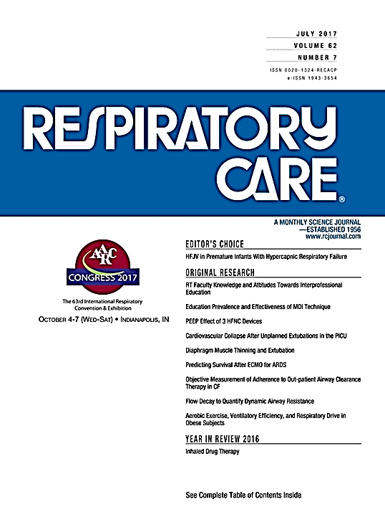
RT Faculty Support of IPCP
Patients are more likely to be treated as a whole person (77%).
Patient care delivery is more efficient (81%).
Health Care quality improves.
Professionals stay enthusiastic about their jobs (70%).
Communication ranked #1 (80%)

Slide 8
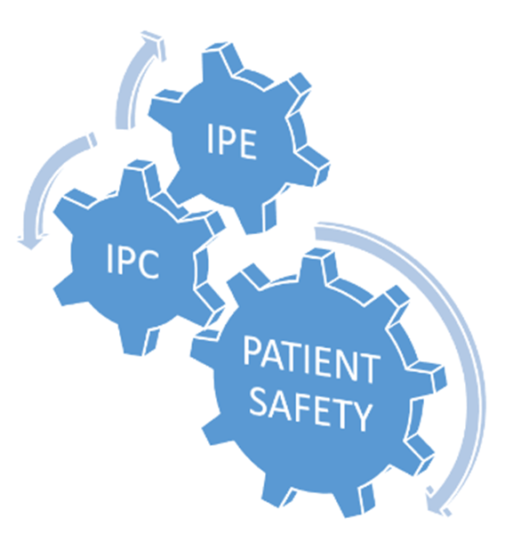
Barriers to IPE
Access to other health-care disciplines
Academic calendars, schedules, facilities
Lack of adequate clinical training sites
Inadequate or no administrative support
Insufficient faculty resources
Lack of standardized assessment tools
Little flexibility within curriculum requirements

Slide 9
Frameworks for IPE
Uses principles of adult learning.
Incorporates learning methods that reflect real practice.
Facilitates interaction between students.
Enhances learning that is holistic, participatory and practical; it can be applied.

Slide 10
Strategies to Address IPE and IPCP
Curricular, Co-curricular
Continuing Education
Required course(s) for all Health Sciences Students (may include nursing, medical and public health students)
IPE Course electives
Required seminars, clinical rotations, labs, simulations, workshops
Voluntary co-curricular IPE days, half-days, rotations, service learning
Integration into existing courses, labs, clinicals
Required health system education and/or certifications
Education for professional CEUs
Voluntary research projects focused on patient safety, quality, costs, effectiveness
Implementation of new protocols
Team based training
Interprofessional Communication
Interprofessional Collaboration

Slide 11



Examples of Required IPE Curricula

Slide 13

IPE Education Model for
Cultural Competency
Clinical Laboratory Sciences
Dental Hygiene
Dentistry
Medicine
Nursing (BSN,CNL)
Occupational Therapy
Physical Therapy
Physician Assistant
Radiologic Sciences
Respiratory Therapy
Core Competencies
(Interprofessional Online Modules and Live Small Group Cases)
Further Competency Development
(Labs, Simulations, Standardized Patients)
Competency Implementation
(Patient Care, Clinical Rotations)
Healthy Perspectives: Better Health care through Better Understanding

Slide 14
Healthy Perspectives
Educational Delivery Model
Assess Biases and Backgrounds
Cultural Differences
Health Beliefs
Demographics and Disparities
Communication
Collaboration
Online Interprofessional Modules
Simulations,
Standardized Patients
Clinical
Interprofessional groups of health professional students
Incorporate by discipline and interprofessional groups
Incorporate by discipline

Slide 15
BuckIPE – an Integrated, Longitudinal Curricular
Framework for Interprofessional Collaboration
FOUNDATION LEVEL: Students learn rationale, supporting evidence, and foundational knowledge and skills for collaborative practice (IPCP).
IMMERSION LEVEL: Modules include team-based learning and simulation, as students consider topics around population health and anti-racism.
MASTERY LEVEL: In the mastery level, students integrate their IPCP skills into practice-based experiences with patients and community members.

Slide 16




Examples of Required Co-Curricular IPE

Slide 17

Case studies
Common readings ahead, registration, pre-tests
Author presentation or case presentation
Small group interactions, work and discussions
Debriefing
Posttests
Faculty Debriefing, Data reporting
Notes:
Julia Fox Garrison- Wrote this funny, inspiring book about how Julia suffered a massive, debilitation stroke at 37 years old. She uses humor to describe some of her care team members as -Dr. Jerk, Dr. Panic and Nurse Doom. She also describe Dr. Neuro who treated her mind as well as her body.
Brian Boyle-Brian Boyle tells a personal story of his fight back from near death after a horrific automobile accident. He focuses on his experience as a patient who, while in a two-month long medically induced coma, was unable to move or talk to anyone around him, yet he was able to hear, see and feel pain. His story give poignant guidance on the patient and family inclusion as members of the care team. Brian’s story about catastrophe, survival, and transcending all odds has implemented new and innovative strategies for improving patient safety and quality of care on a national level, as well as serving as a learning experience for healthcare providers of all levels and backgrounds.
Sam Quinones- 1929, in the blue-collar city of Portsmouth, Ohio, a company built a swimming pool the size of a football field; named Dreamland, it became the vital center of the community. Then, addiction has devastated Portsmouth, as it has hundreds of small rural towns and suburbs across America—addiction like no other the country has ever faced. How that happened is the riveting story of Dreamland.
The unfettered prescribing OxyContin during the 1990s reached its peak in Purdue Pharma's campaign to market its new, expensive—and extremely addictive—miracle painkiller. Together these phenomena continue to lay waste to communities from Tennessee to Oregon, Indiana to New Mexico.
Dr. Margaret Kitt-Disaster Preparedness 101. Students read articles about NIOSH and Disaster Preparedness. They worked in interprofessional teams and prepared a public service announcements to inform our area in Hampton Roads about hurricane preparedness, evacuation, safety and resources.

Slide 18
INTERPROFESSIONAL CASES and SIMULATIONS

Slide 19
Teamwork Before and After IPE
Experiential learning strategies and a case study approach
Role and responsibilities competency
Student’s (N=376) attitudes about teamwork were measured pre and pos
Interprofessional Attitudes Scale, Teamwork, Roles, and Responsibilities Subscale, TRR (α = .91).
Students from 8 health care disciplines were randomly assigned

Slide 20
Our Findings
Significant gains in pretest-posttest TRR (p<.001) for all students.
Undergraduate students scored significantly higher on both the pretest and posttest
Our findings are consistent with studies suggesting students differed in attitudes towards IPE based on discipline.
Dental hygiene students had the highest pre and post TRR scores.
Although PT students had significant gains in TRR, their pre and post test scores were significantly lower than other groups

Slide 21
Interprofessional Education in a Pediatric Simulation: Case of an Infant with Fever
Case Overview
You will be participating in a simulated pediatric patient-care exercise as part of an interprofessional healthcare team. In the setting of a local emergency department during the winter break, you will be asked to evaluate and treat an infant who is brought-in by her parent with a complaint of fever, cough, runny nose, congestion and wheezing. The child has been lethargic with little appetite but is awake on arrival with appearance of trouble breathing.
Be prepared to participate fully in this exercise by engaging in many different roles to provide assessment and care for this patient, as part of the team.

Slide 22
Learning Objectives
Demonstrate the application of psychomotor skills necessary for the completion of required pediatric patient-care tasks, respective to your discipline.
Formulate a problem-based, prioritized assessment for the care of the child.
Analyze your respective roles and those of other members of the interprofessional team as they pertain to the care of an infant with a febrile illness.
Demonstrate the ability to place the patient and the family at the center of the healthcare delivery through empathy, respect, and communication.
Apply principles of effective interpersonal communication with a standardized patient (parent), with other students, and with faculty.
Utilize communication tools to promote an environment of patient safety.

Slide 23
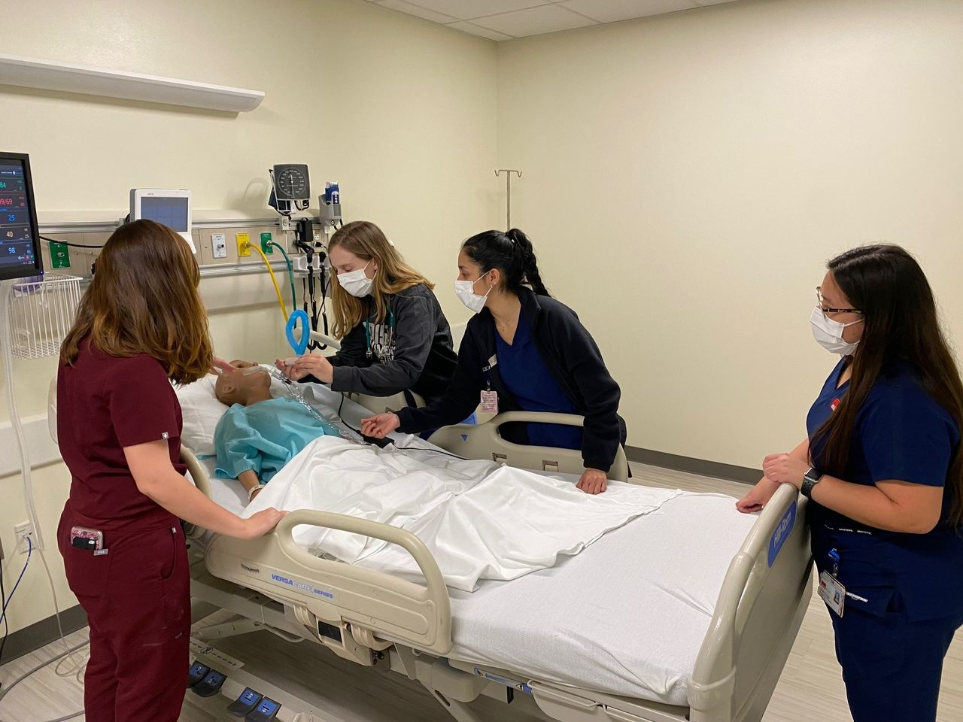
7 Simulations Respiratory Care Students and Medical Students
Notes:
UTMBHealth, Galveston TX: 1. oxygen delivery devices 2 intubation, 3. mechanical ventilation, 4. artificial airway management, 5. liberation (patient centered care) 6. emergent interventions.

Slide 24
Patient Scenario | Condition Progression | Expected Student Response
COPD exacerbation | Stable, middle aged male with exacerbation of COPD • develops dyspnea upon movement for chest x-ray • receives bronchodilator via hand-held nebulizer • develops extreme dyspnea, oxygen desaturation | Nursing student • performs initial and change in status assessment; • calls for chest Xray • Radiologic science student • obtains portable chest x-ray • reassesses need for 2nd x-ray Respiratory therapy student • responds to call for ‘prn’ bronchodilator treatment; assess and treat
Elderly patient | Stable elderly patient with history of CVA, suspected femur fracture • Family member gives patient water; patient chokes, becomes dyspneic, desaturates | Nursing student • performs initial and change in status assessment; • calls for x-ray of femur Radiologic science student • enters to obtain leg fracture x-rays • reassesses for need for 2nd x-ray Respiratory therapy student • responds to call for acute dyspnea and desaturation; assess and treat
Chronic tracheostomy patient admitted from home | Chronic tracheostomy patient with possible pneumonia • receives routine portable chest x-ray • family assists moving patient and accidentally repositions tracheostomy tube out of place | Nursing student •performs initial and change in status assessment •calls for routine portable chest x-ray Radiologic science student • obtains portable chest x-ray • reassesses need for 2nd x-ray Respiratory therapy student •responds to call for acute dyspnea and desaturation; assess and treat
Notes:
Northern Kentucky University

Slide 25
BOOKS DISCUSSIONS OF PERSONAL
HEALTH EXPERIENCES

Slide 26



Disaster Preparedness 101
Dr. Margaret M. Kitt, Assistant Surgeon General

Slide 27
Imagine spending two months in a coma, undergoing 14 major operations, receiving 36 blood transfusions, and getting 13 plasma treatments. Welcome to Brian Boyle’s world. One day in 2004 changed his life forever when his car crashed with a dump truck. His body shattered, he was placed in a chemically induced coma for two months
Brian Boyle’s story about catastrophe and survival has pushed new and innovative strategies for improving patient safety and quality of care on a national level, serving as a learning experience for healthcare providers of all levels
Notes:
An interprofessional education (IPE) approach that combined book reading, a presentation by the author of the book, and small group discussion of a case study focused on patient safety was used to introduce students to HP roles and responsibilities and to highlight the benefits of IPCP. Patient safety is an effective platform for engaging students in IPE learning and exposing them to the benefits of teamwork and interprofessional collaboration as demonstrated in this study.

Slide 28
Our Findings
Student discipline-nursing
Educational level -undergrads
Prior participation-1-2 prior IPE learning
Notes:
Students with no prior IPE experience did not demonstrate significant gains but had sig. higher pretest and posttest scores
Students with 1-2 prior IPE had significant gains in posttest compared to pretest scores
Nursing students had significantly higher pretest and posttest scores. Students with no prior IPE experience did not demonstrate significant gains but had sig. higher pretest and posttest scores
Students with 1-2 prior IPE had significant gains in posttest compared to pretest scores
Nursing students had significantly higher pretest and posttest scores
Students with no prior IPE did not have significant gains in scores, but had higher pretest and posttest scores

Slide 29
Implications for Interprofessional Practice
Can overcome common barriers of scheduling, time constraints and curricular overload
Students can prepare in advance through assignment readings prior to team-based learning.
Effective strategy for incorporating the patients’ perspectives for patient-centered approaches to healthcare safety.
Can positively attitudes toward teamwork.

Slide 30
Competitions and Free Clinics

Slide 31
Innovation in Action: Solutions to Big Challenges
This competition harnesses the talents of students to address challenging problems. The program equips students from many disciplines with an innovator’s toolkit in a supportive environment that combines student skills with their creativity to impact the public’s health.
U-M Student-Run Free Clinic (UMSRFC)
Dedicated to providing quality healthcare free of charge to uninsured community members, while creating opportunities for U-M students and physicians to confront health disparities through direct action.

Slide 32
First Time IPE Educators
Reach out to your colleagues who succeed at IPE
Try to join an existing IPE team
Observe and collaborate with experienced IPE teachers
Contribute to the development of new IPE programs
Seek institutional support
Undertake IPE evaluation and research
Gain high-level institutional endorsement.

Slide 33
Thank you!
Questions?

